Slide 1
Microsoft Excel 1
QCL Graduate Fellow

Slide 2
Before we start
Microsoft Excel
Survey sign-in
Github link
https://www.microsoft.com/en-us/education/products/office

Slide 3
Agenda
Excel Overview
Excel Worksheets
Structure
Today’s Data
Content
Sort, filter, conditional formatting
VLOOKUP (extact match)
Calculations (mean, min and max)
Frequency and histogram
Hands-on Exercises throughout
Pivot table and chart

Slide 4
Excel Overview
Popular: commonly used program
Data entry: imputing data to make sense of information
Calculations: simple and complex to a point
Visuals: tables, plots and diagrams

Slide 5




Today’s Goals
Learn how to move data around with Sort
Learn how to highlight and hide data with Filter and Conditional Formatting
Make a simple search feature with VLOOKUP (exact match)
Make simple Calculations about your data
Put data in “boxes” for visuals with Frequency
A quicker way to look at data with Pivot Table and Pivot Chart

Slide 6
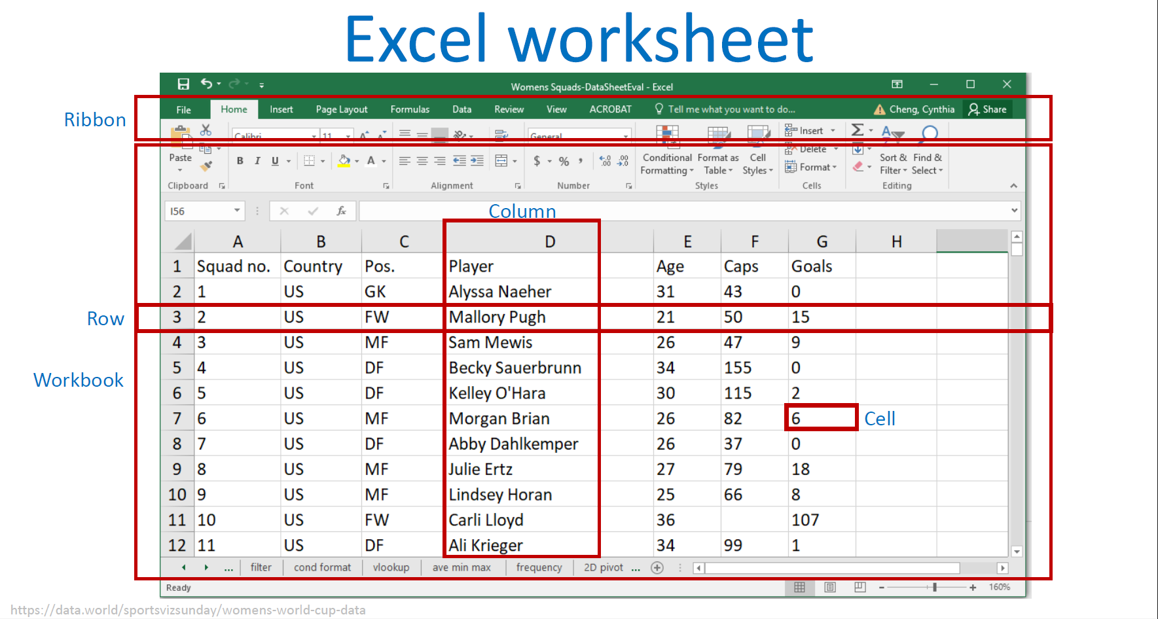

Slide 7
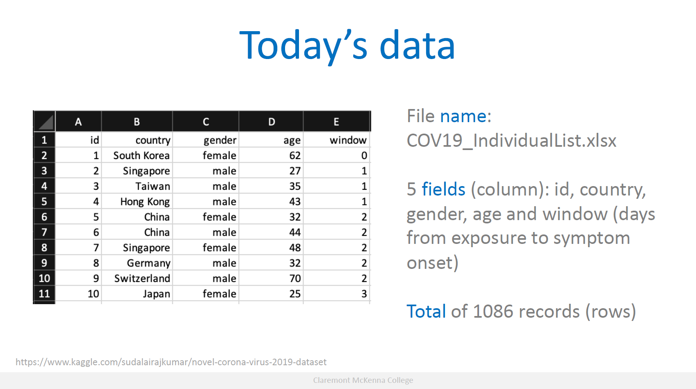

Slide 8
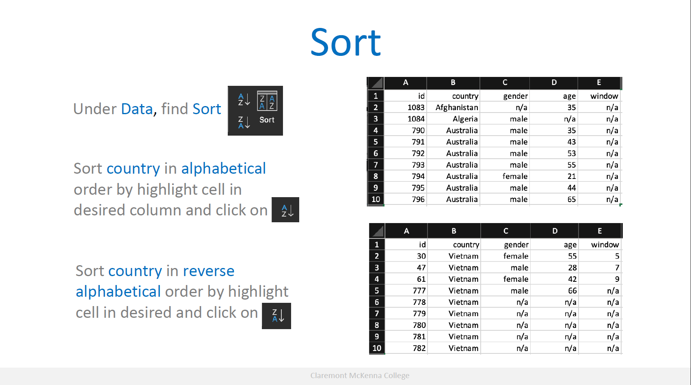

Slide 9
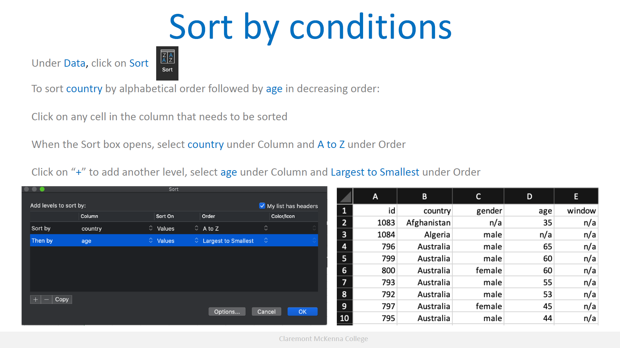

Slide 10
Hands-on exercise #1
Using the Broadway data set:
Go to the “broadway” data sheet in the workbook
Generate the output for sorting show type first followed by show title in alphabetical order.

Slide 11
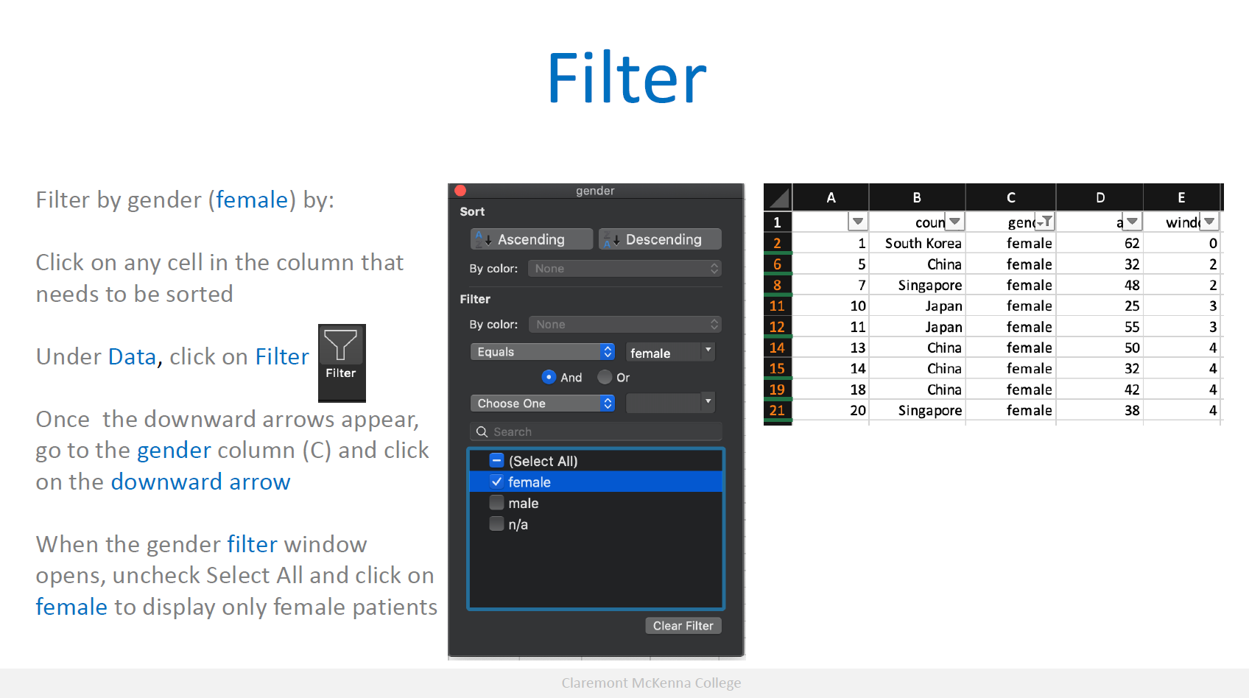

Slide 12
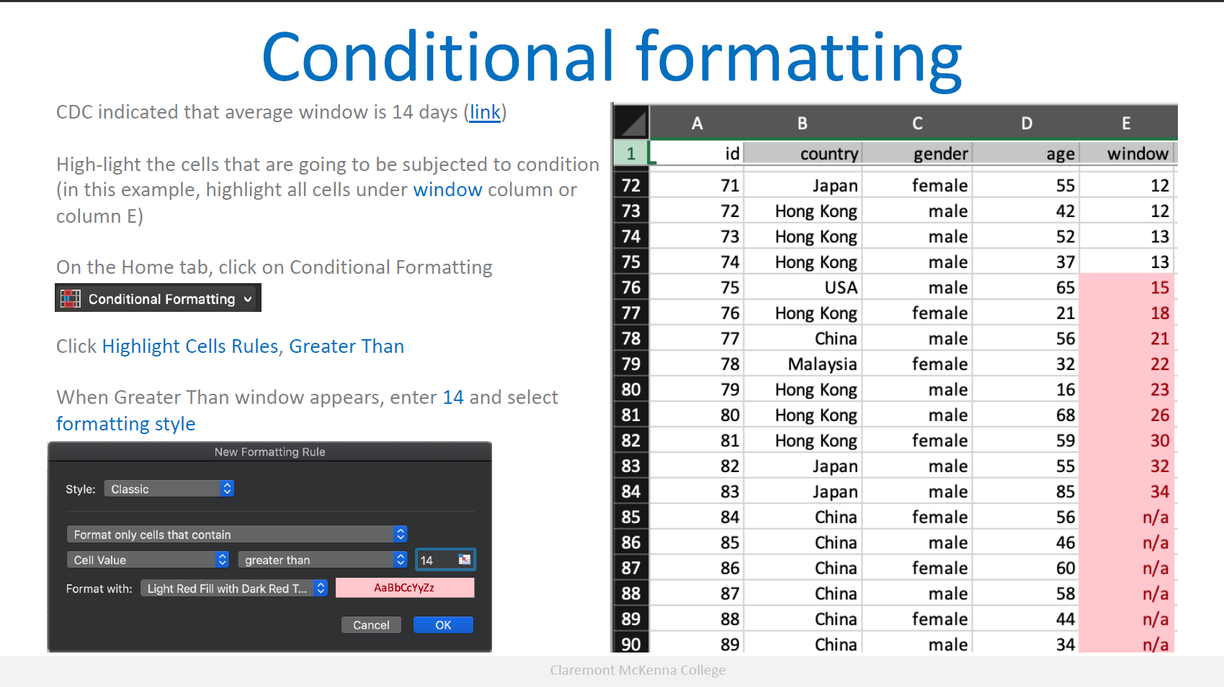

Slide 13
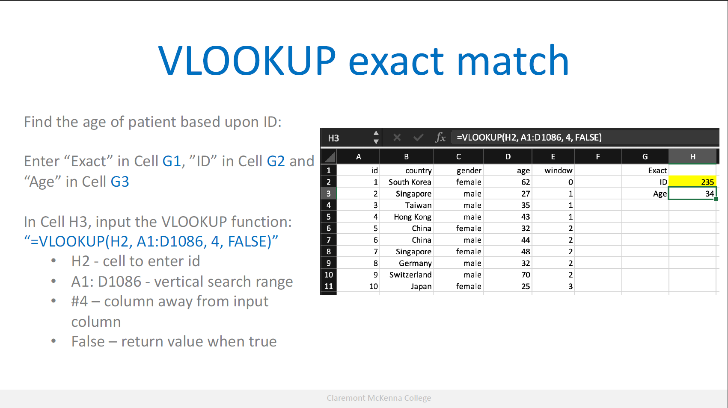

Slide 14
Hands-on exercise #2
Using the Broadway data set:
Suppose that you are the theatre manager for Richard Rogers Theatre, where Hamilton is playing (see tab that is named “hamilton”), what are the exact VLOOKUP functions that can be used to find the statistics attendance, capacity and number of performances, by entering the Date.Full?

Slide 15
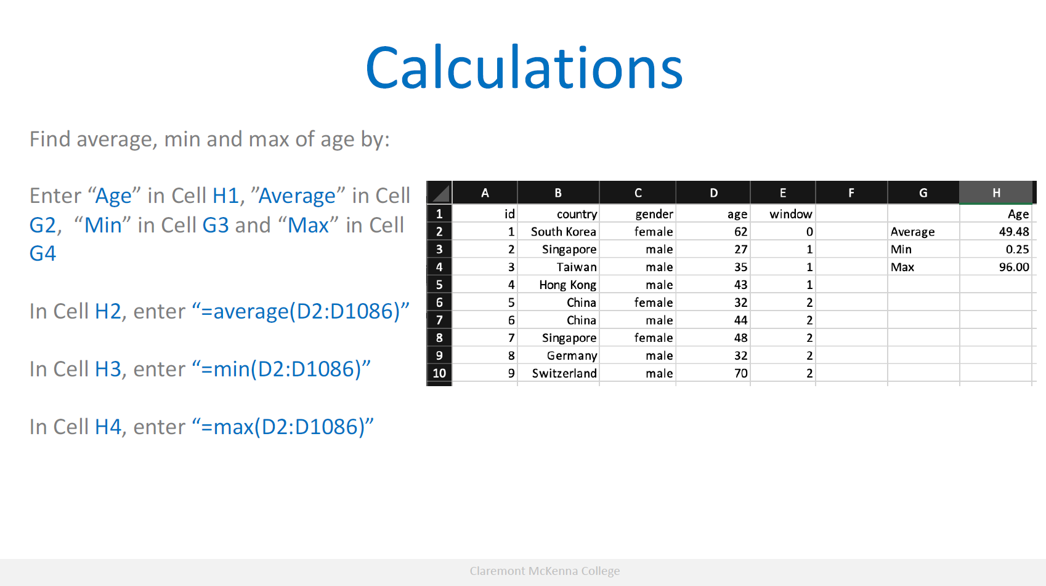
Note: excel understands the difference between text and numbers, if you use the right data type.

Slide 16
Hands-on exercise #3
Using the Broadway data set:
Go to the “broadway” data sheet in the workbook
Calculate minimum, maximum and average values for statistics attendance and capacity using the whole data set.

Slide 17
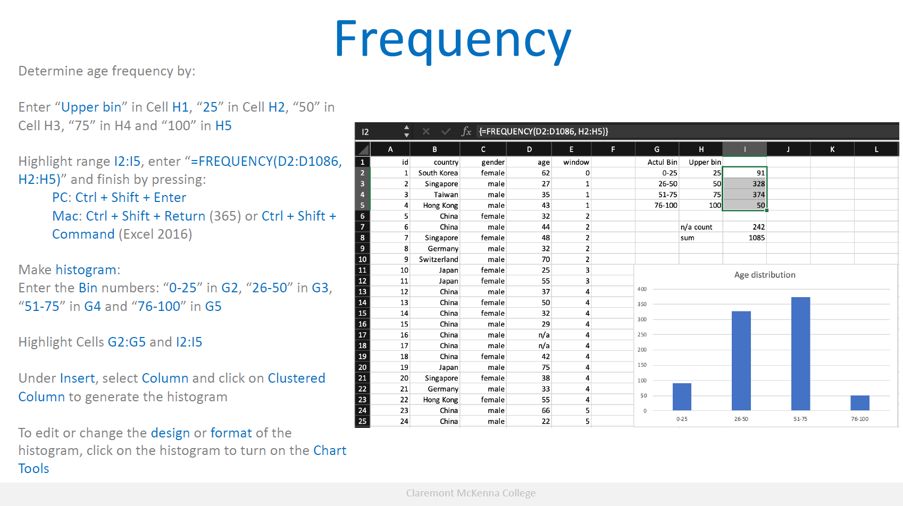

Slide 18
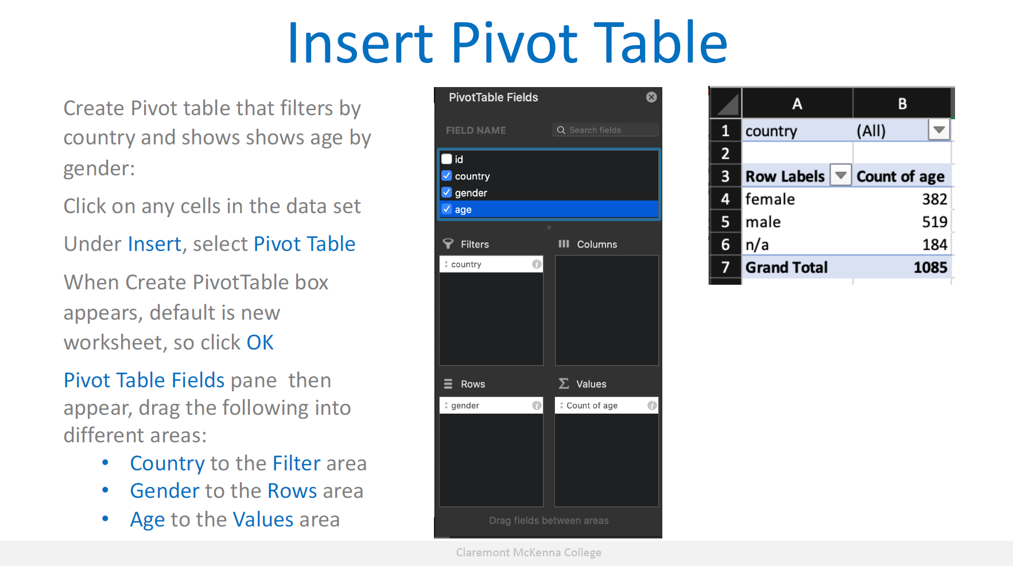

Slide 19
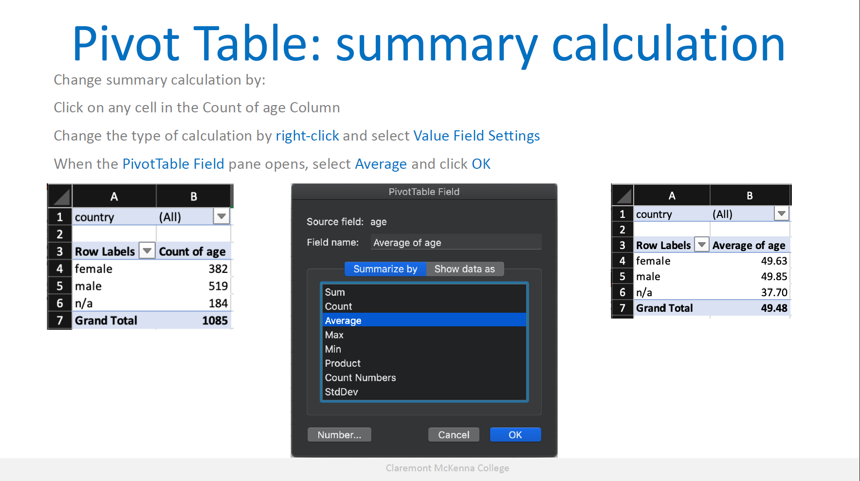

Slide 20
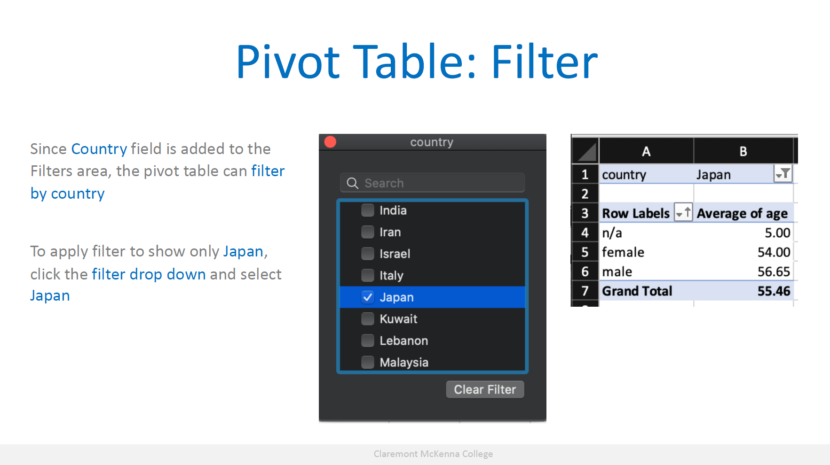

Slide 21
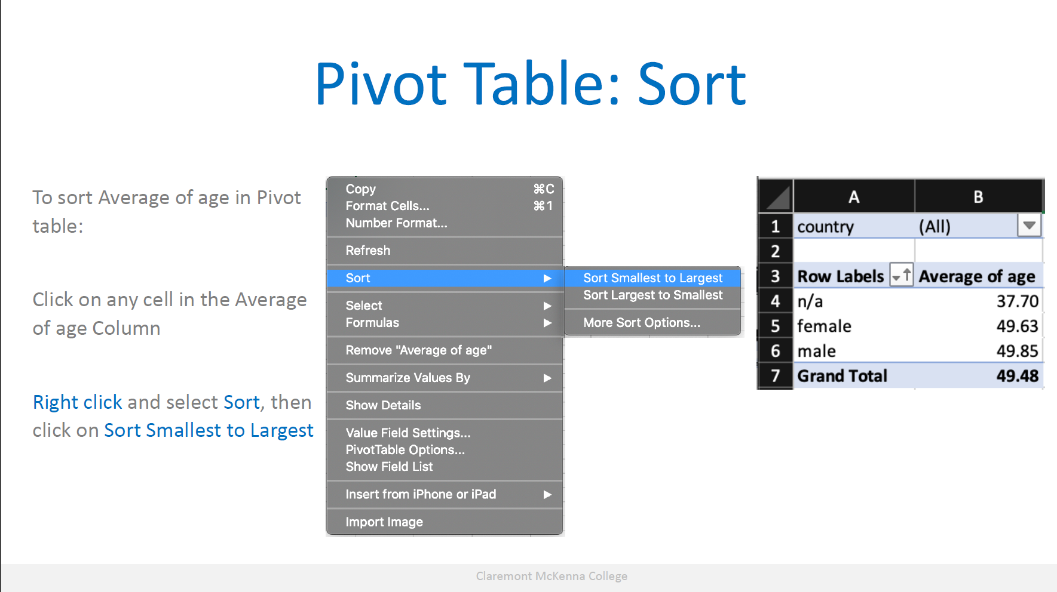

Slide 22
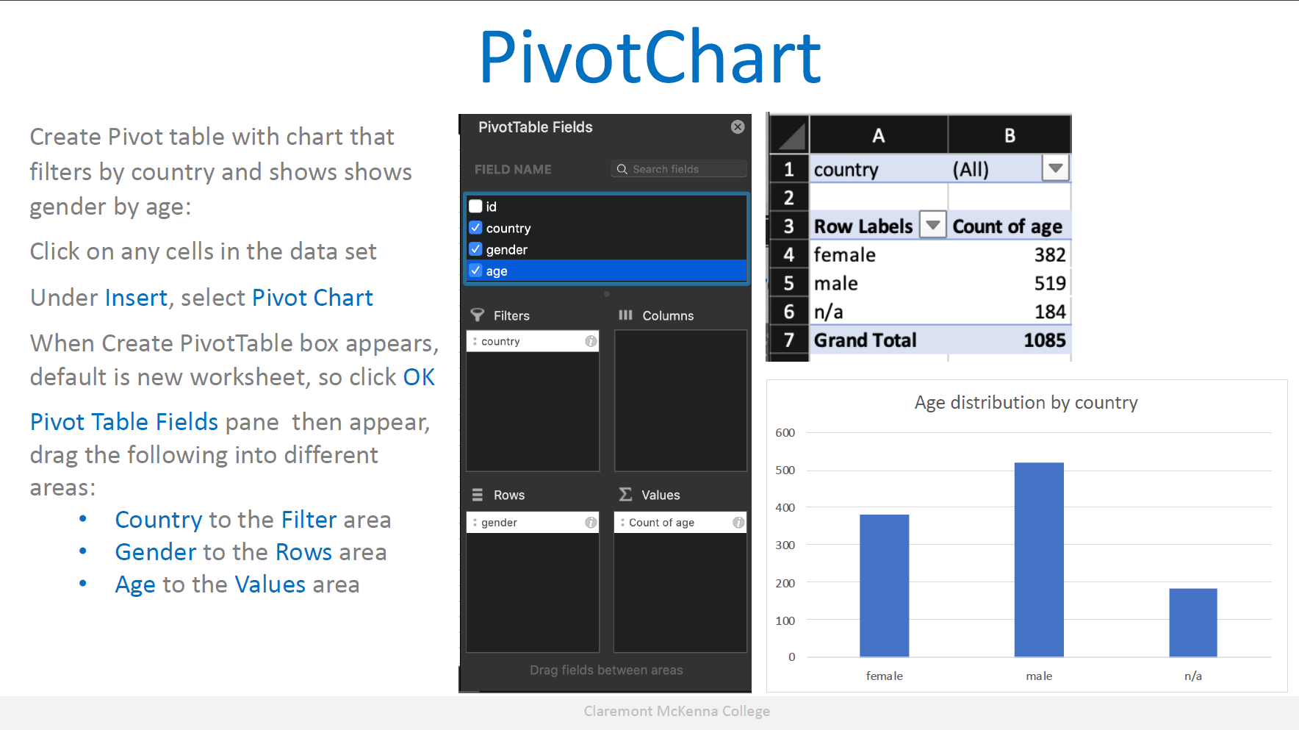

Slide 23
Hands-on exercise #4
Using the Broadway data set:
Go to the “broadway” data sheet in the workbook
Build a pivot table that is filterable by year, theatre name and show name to show the number of audience attendance for each show type. With the table, answer the following questions:
a. What’s average of total audience attendance for all the show type?
b. What is the total number of audience attendance for the Imperial Theatre in the year of 2010?

Slide 24
The more you know…
There are lots of features and functions in Excel than what you think
Practice makes perfect, the more you use it, the better you will be
Lots of resources:
Microsoft: https://support.office.com/en-us/article/excel-forwindows-training-9bc05390-e94c-46af-a5b3-d7c22f6990bb
Excel Exposure: https://excelexposure.com/lesson-guide/
Contextures: https://www.contextures.com/
LinkedIn Learning: https://www.cmc.edu/informationtechnology/linkedin-learning

Slide 25
Future Workshops
Excel Level 2
Lookup functions
VLOOKUP (approximate match)
Index Match
Common functions
Count
Sum
Logical functions
IF
AND
OR
NOT

Slide 26
Contact info
QCL: QCL@cmc.edu
Vanessa Casillas: vanessa.casillas@claremontmckenna.edu

